Slide 1
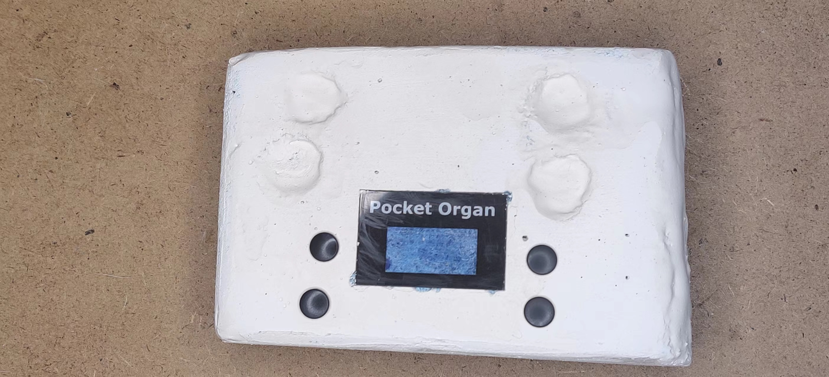
Melody
Up
Octave+
Up
Drum
Down
Octave-
Down
Volume
Loop
Instr.
Capo

Slide 2
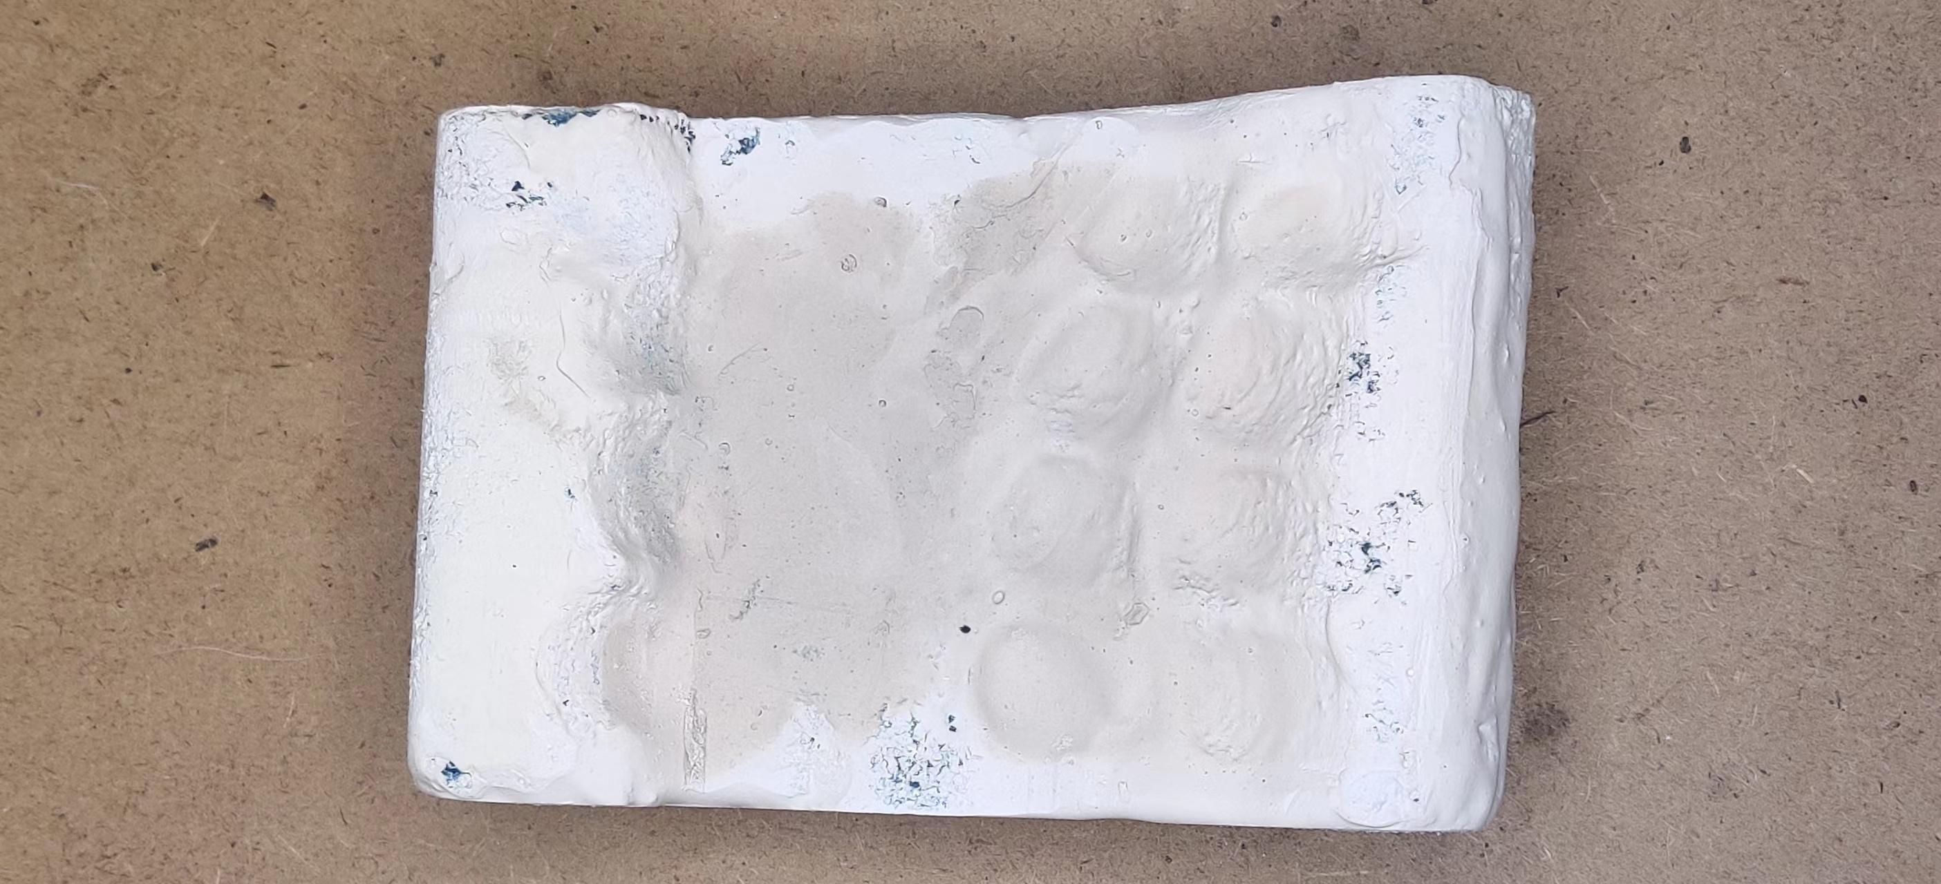
B
3rd
5th
E
A
7th
D
G
Minor
C
F

